Slide 1
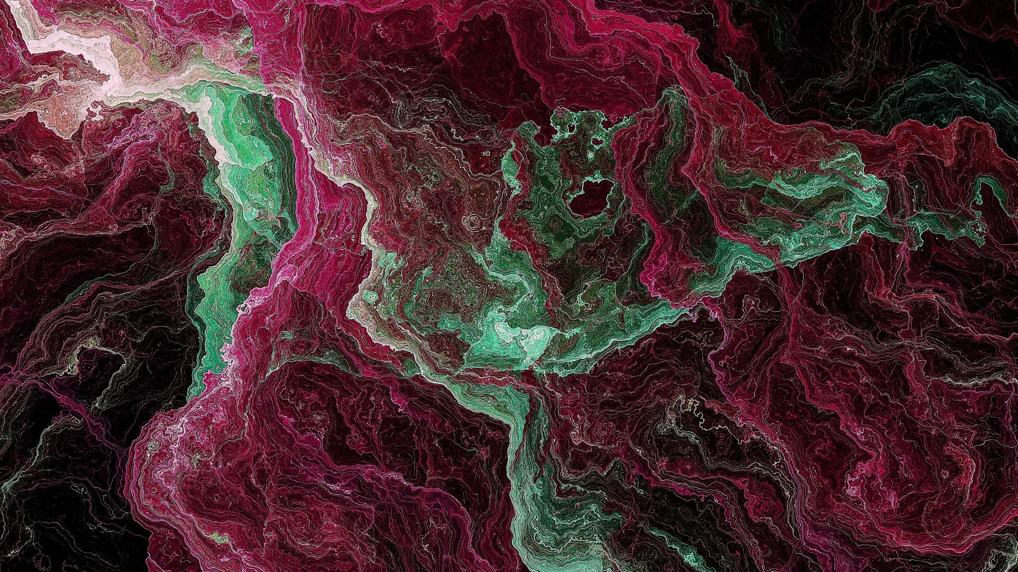
artificial face generation Batch 38
Sathvik 190330219
Srinivas 190330213
Akshay 190330253
Ritish 190330145

Slide 2
COntents
Introduction
Model Description
Feasibility
Software Requirements
Hardware Requirements
Survey
Conclusion

Slide 3
Introduction
Artificial face generation using GAN s.
GAN (Generative Adversarial Networks) models in computer vision has enabled the creation of artificial face images that are visually indistinguishable from genuine ones.
“Traditional” generative models are based on maximum likelihood techniques like Gaussian mixture model (GMM) . GANs provide an attractive alternative to “traditional” generative models. Style GAN s are a used for generation of high resolution images .

Slide 4
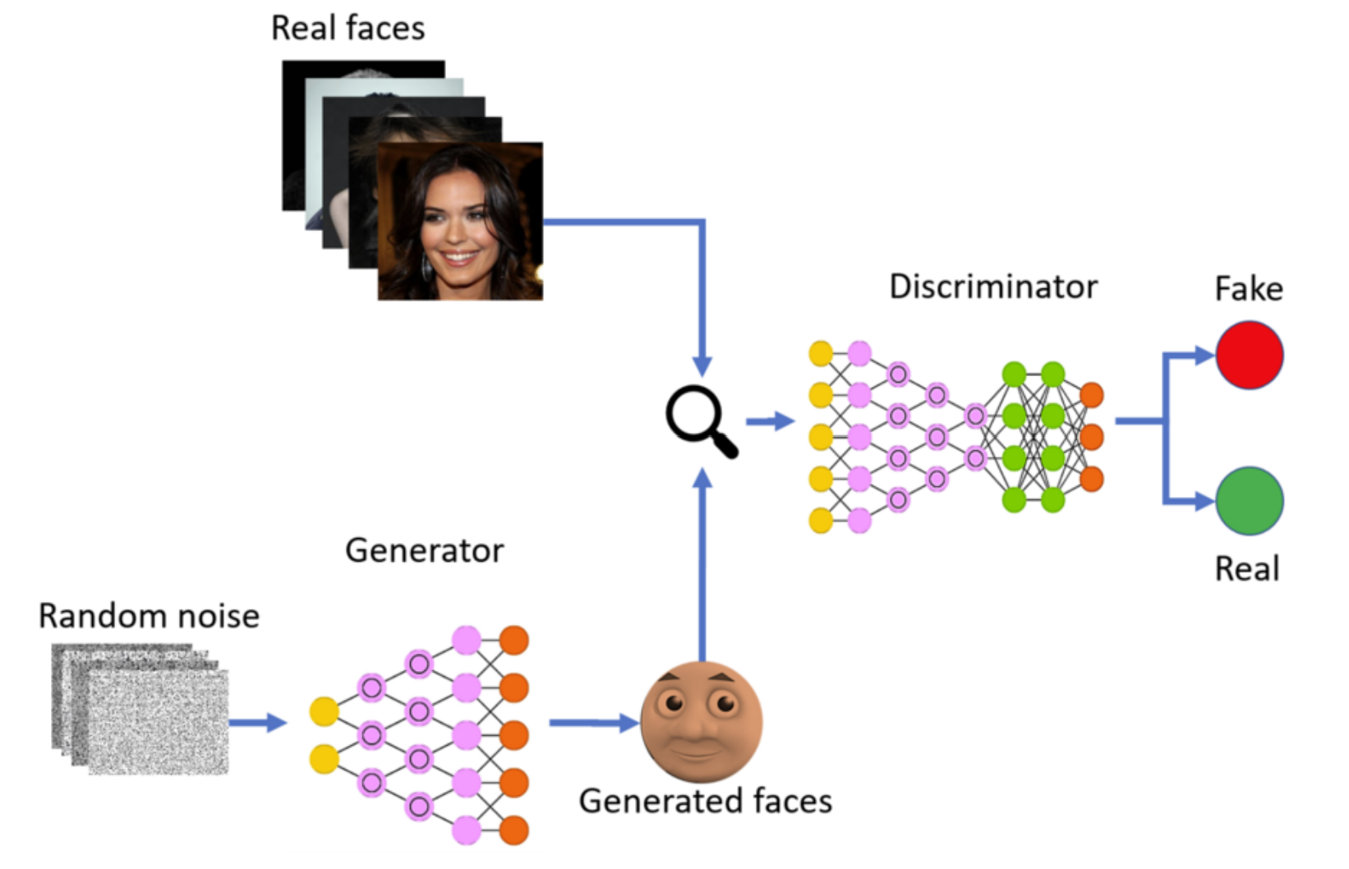
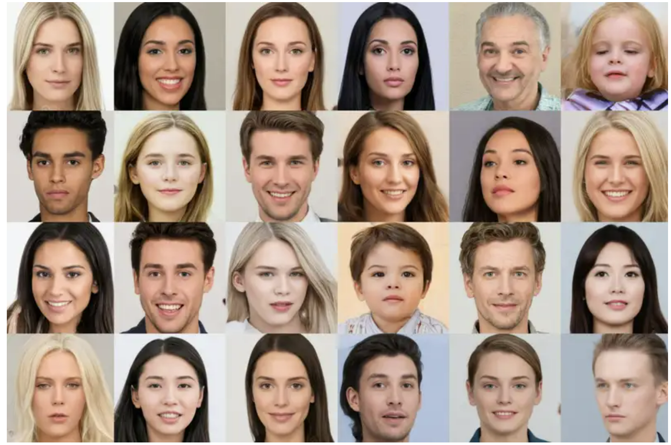
Model Description

Slide 5
Model Description
Components of GANs
Generator : Generator is a neural network that learns to generate data which resemble with the input distribution. The generator model takes fixed dimension of a random vector from Gaussian distribution as input and generates the sample out of it which resemble with input.
Discriminator : Discriminator is also a neural network that detects fake and real data . The discriminator model takes an example from the domain as input (real or generated) and predicts a binary class label of real or fake.

Slide 6
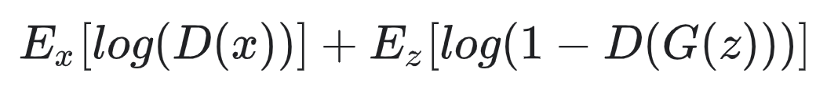
Model Description
Loss Function ( Minimax loss )
A GAN can have two loss functions: one for generator training and one for discriminator training.
The generator and discriminator losses derive from a single measure of distance between probability distributions.
The generator can only affect one term in the distance measure: the term that reflects the distribution of the fake data. So during generator training we drop the other term, which reflects the distribution of the real data.

Slide 7
Model Description
Loss Function ( Minimax loss )
D(x) is the discriminator's estimate of the probability that real data instance x is real.
Ex is the expected value over all real data instances.
G(z) is the generator's output when given noise z.
D(G(z)) is the discriminator's estimate of the probability that a fake instance is real.
Ez is the expected value over all random inputs to the generator (in effect, the expected value over all generated fake instances G(z)).

Slide 8
Feasibility
Technical Feasibility: As this project mainly focuses on Deep Neural Networks we require lot of frameworks for computation of large datasets and training our model .
Economic Feasibility: This project doesn't require any money as most of the software required are available for free i.e open source
Legal Feasibility: We make sure that we won’t use any illegal source or information for this project.

Slide 9
Software Requirements
Visual Studio Code
Jupyter Notebook
Google CoLab
Python 3.7
Nvidia Cuda 11.6
Nvidia CuDNN 8.3
Tensorflow
PyTorch

Slide 10
hardware Requirements
Processor : Intel I7
Processor speed : 2.4 GHz
Hard Disk : 10 GB (Min)
RAM : 8 GB
GPU : GeForce RTX 3050

Slide 11
Yann LeCun and Corinna Cortes. “MNIST handwritten digit database”. In: (2010). url: http://yann.lecun.com/exdb/mnist/.
Zoubin Ghahramani et al., eds. Advances in Neural Information Processing Systems 27: Annual Conference on Neural Information Processing Systems 2014, December 8-13 2014, Montreal, Quebec, Canada. 2014
Mehdi Mirza and Simon Osindero. “Conditional Generative Adversarial Nets”. In: CoRR abs/1411.1784 (2014). url: http://arxiv.org/ abs/1411.1784.
Ziwei Liu et al. “Deep Learning Face Attributes in the Wild”. In: Proceedings of International Conference on Computer Vision (ICCV). 2015.
Alec Radford, Luke Metz, and Soumith Chintala. “Unsupervised Representation Learning with Deep Convolutional Generative Adversarial Networks”. In: CoRR abs/1511.06434 (2015).
Survey

Slide 12
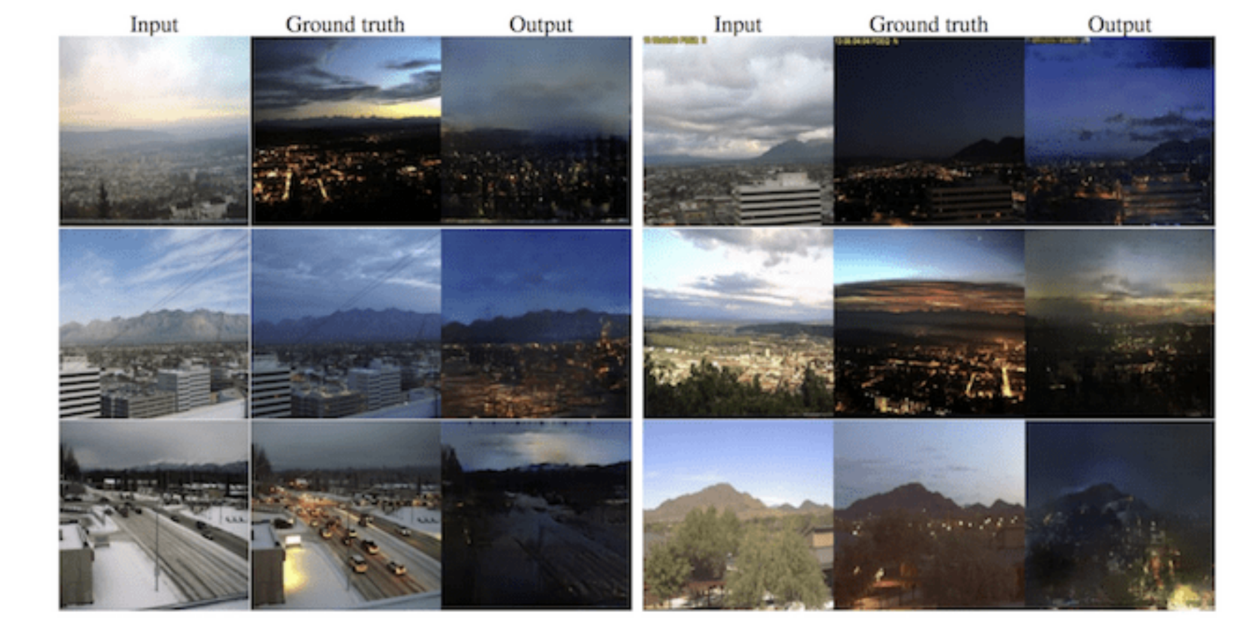
Conclusion
Other interesting applications of GANs :
Image-to-Image Translation

Slide 13
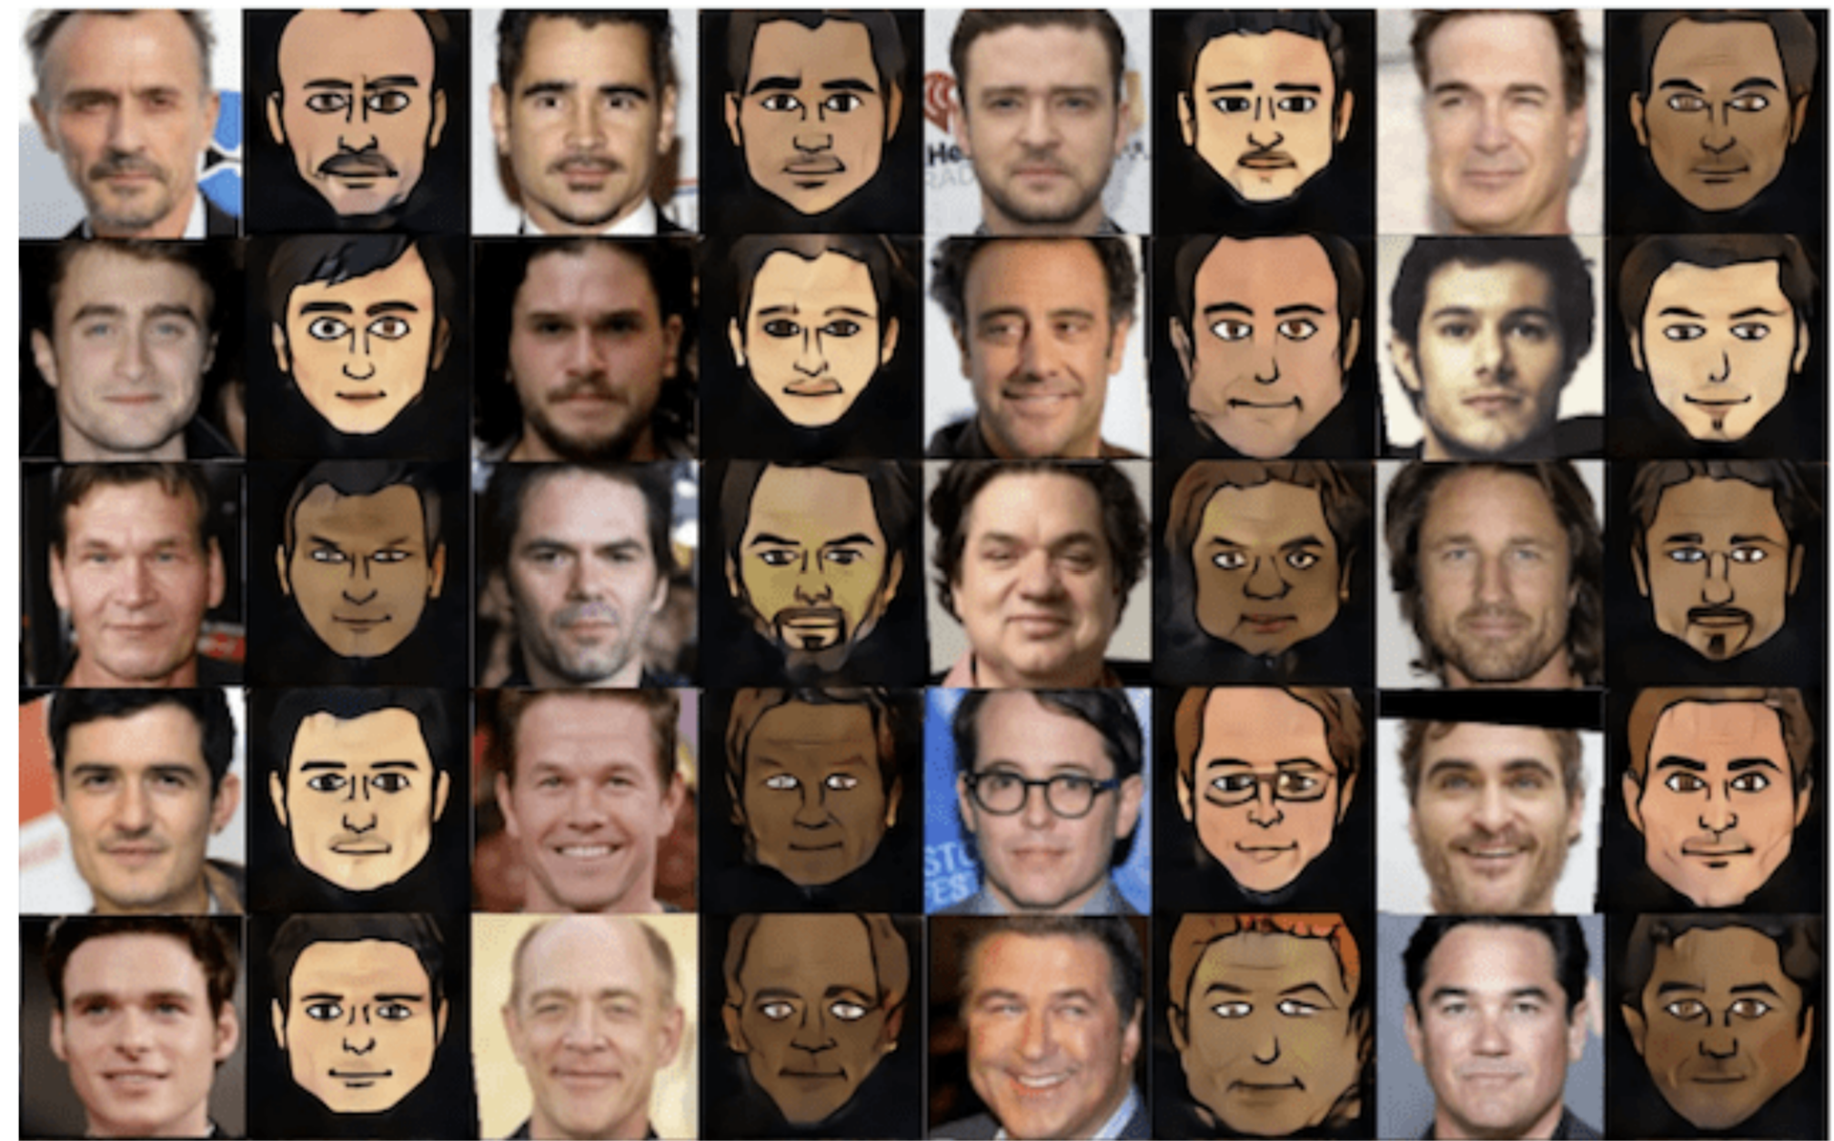
Photos to Emojis

Slide 14
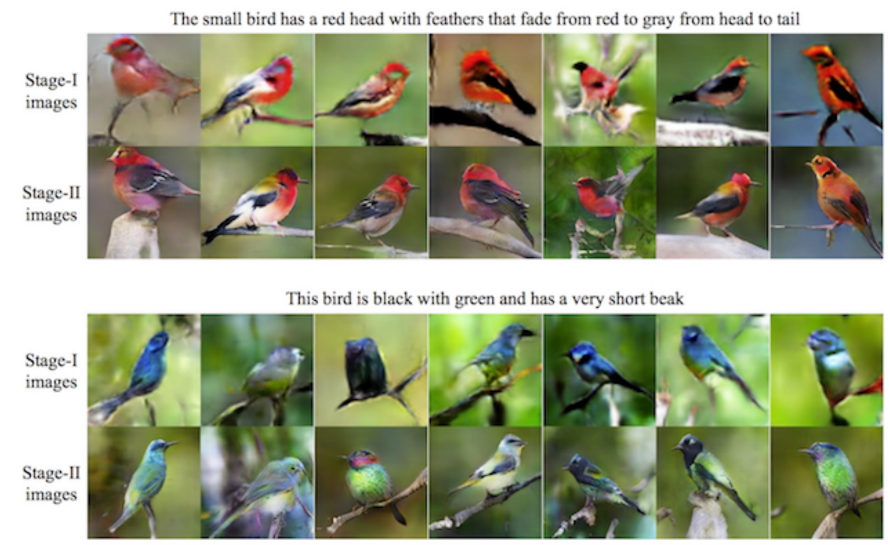
Text to image Translation

Slide 15


